Slide 1






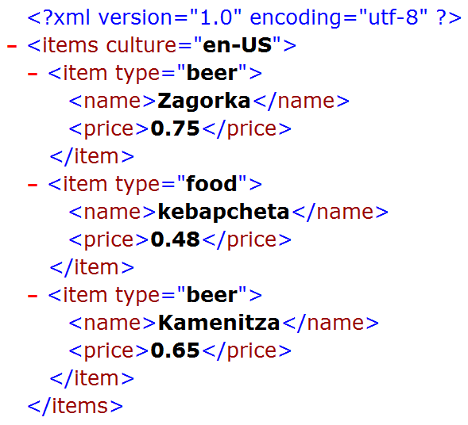
Basic XML Concepts
XML, Nodes, Attributes, Namespaces, Schemas, XPath, XSL Transformations
SoftUni Team
Technical Trainers
Software University
http://softuni.bg

Slide 2

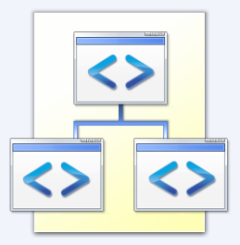
Table of Contents
What is XML?
XML and HTML
XML Namespaces
XML Schemas and Validation
DTD and XSD Schemas
XML Parsers: DOM, SAX, StAX
XPath Language
XSL Transformations

Slide 3

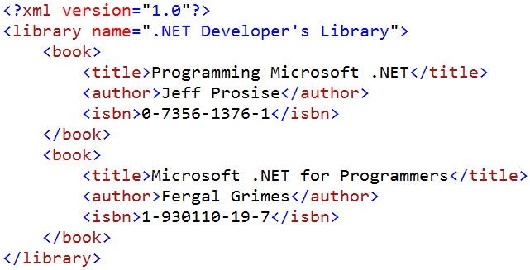
What is XML?

Slide 4
XML – Example
<?xml version="1.0"?>
<library name="Developer's Library">
<book>
<title>Professional C# 4.0 and .NET 4</title>
<author>Christian Nagel</author>
<isbn>978-0-470-50225-9</isbn>
</book>
<book>
<title>Teach Yourself XML in 10 Minutes</title>
<author>Andrew H. Watt</author>
<isbn>978-0-672-32471-0</isbn>
</book>
</library>

Slide 5
What is XML?
XML (eXtensible Markup Language)
Universal notation (data format / language) for describing structured data using text with tags
The data is stored together with the meta-data about it
Used to describe other languages (formats) for data representation
XML looks like HTML
Text based language, uses tags and attributes

Slide 6

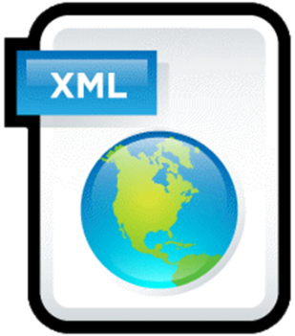
What is XML? (2)
Industrial standard, supported by the W3C (www.w3c.org)
Independent of the hardware platform, OS and programming languages

Slide 7
XML – Example
XML header tag (prolog)
Attribute (key / value pair)
<?xml version="1.0"?>
<library name="Developer's Library">
<book>
<title>Professional C# 4.0 and .NET 4</title>
<author>Christian Nagel</author>
<isbn>978-0-470-50225-9</isbn>
</book>
<book>
<title>Teach Yourself XML in 10 Minutes</title>
<author>Andrew H. Watt</author>
<isbn>978-0-672-32471-0</isbn>
</book>
</library>
Root (document) element
Element
Opening tag
Closing tag
Element value

Slide 8

XML and HTML
Similarities between XML and HTML
Both are text based notations
Both use tags and attributes
Differences between XML and HTML
HTML is a language, and XML is a syntax for describing other languages (meta-language)
HTML describes the formatting of information, XML describes structured information
XML requires the documents to be well-formed

Slide 9
Well-Formed XML Documents
Well-formed XML:
Means "syntactically correct XML document"
All tags should be closed in the correct order of nesting
Attributes should always be closed
The document should contain only one root element
Tag and attribute names retain certain restrictions

Slide 10


Well-Formed XML Documents (2)
Example of incorrect XML document
Open / close tags do not match
Unclosed attribute values
Invalid characters, invalid spacing
Check for well-formed XML online: http://xmlvalidation.com
<xml>
<button bug! value="OK name="b1">
<animation source="trailer.avi"> 1 < 2 < 3
</click-button>
< / xml >

Slide 11

Special Characters in XML Documents
Some characters are invalid in XML documents, e.g. "<" and ">"
Special characters can be escaped XML entities:
Unicode character nnnn (decimal): &#nnnn;
Unicode character hhhh (hexadecimal): &#hhhh;
Named entities: &name;
<escaped-tags>
&quot;&#169; 2015 &#x2122;&quot;
&amp; &apos;A&#9827;&apos; &lt;xml&gt;
</escaped-tags>
XML entities

Slide 12
CDATA – Unparsed Character Data
XML documents may hold character data (CDATA) fragments:
<script>
<!–- This is unparsed CDATA section -->
<![CDATA[
function compare(a, b) {
if (a < 0 && b < 0) {
return "a & b < 0";
} else {
return 'a & b >= 0';
}
}
]]>
</script>
XML comment
XML CDATA (unparsed) section

Slide 13
XML: Benefits
Benefits of XML:
XML is human readable (unlike binary formats)
Store any kind of structured data
Data comes with self-describing meta-data
Full Unicode support
Exchange data between different systems
Custom XML-based languages can be designed for certain apps
Parsers available for virtually all languages and platforms

Slide 14
When to Use XML? (2)
Disadvantages of XML:
XML data is bigger (takes more space) than in binary formats
More memory consumption, more network traffic, more hard-disk space, more resources
Decreased performance
CPU consumption: need of parsing / constructing the XML tags
XML is not suitable for all kinds of data
E.g. graphics, images and video clips

Slide 15
What is XML?
Live Demo

Slide 16

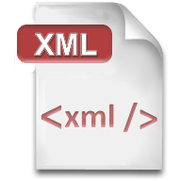

XML Namespaces

Slide 17
XML Namespaces
XML namespaces are defined like this:
<?xml version="1.0" encoding="utf-8"?>
<sample:towns xmlns:sample="http://www.sample.org/towns/1.0">
<sample:town>
<sample:name>Sofia</sample:name>
<sample:population>1200000</sample:population>
</sample:town>
<sample:town>
<sample:name>Plovdiv</sample:name>
<sample:population>700000</sample:population>
</sample:town>
</sample:towns>

Slide 18
XML Namespaces (2)
XML namespaces allow multiple tags with the same name:
<?xml version="1.0" encoding="UTF-8"?>
<country:towns
xmlns:country="urn:sample-org:country"
xmlns:town="http://www.sample.org/towns/1.0">
<town:town>
<town:name>Plovdiv</town:name>
<town:population>700000</town:population>
<country:name>Bulgaria</country:name>
</town:town>
</country:towns>

Slide 19
Namespaces – Example
<?xml version="1.0" encoding="UTF-8"?>
<country:towns xmlns:town="http://www.sample.org/towns/1.0"
xmlns:country="urn:sample-org:country">
<town:town>
<town:name>Sofia</town:name>
<town:population>1200000</town:population>
<country:name>Bulgaria</country:name>
</town:town>
<town:town>
<town:name>Plovdiv</town:name>
<town:population>700000</town:population>
<country:name>Bulgaria</country:name>
</town:town>
</country:towns>
Namespace with prefix "country" and URI "urn:sample-org:country"
Tag named "name" from namespace "country" → the qualified tag name is "{urn:sample-org:country}name"

Slide 20
Default Namespaces
<?xml version="1.0" encoding="windows-1251"?>
<order xmlns="http://www.supermarket.com/orders/1.1">
<item>
<name>Beer "Zagorka"</name>
<amount>8</amount>
<measure>bottle</measure>
<price>5.60</price>
</item>
<item>
<name>Meat balls</name>
<amount>12</amount>
<measure>piece</measure>
<price>5.40</price>
</item>
</order>
Default namespace – applied for the entire XML document
The full (qualified) tag name is "{http://www.supermarket.com/orders/1.1}measure"

Slide 21
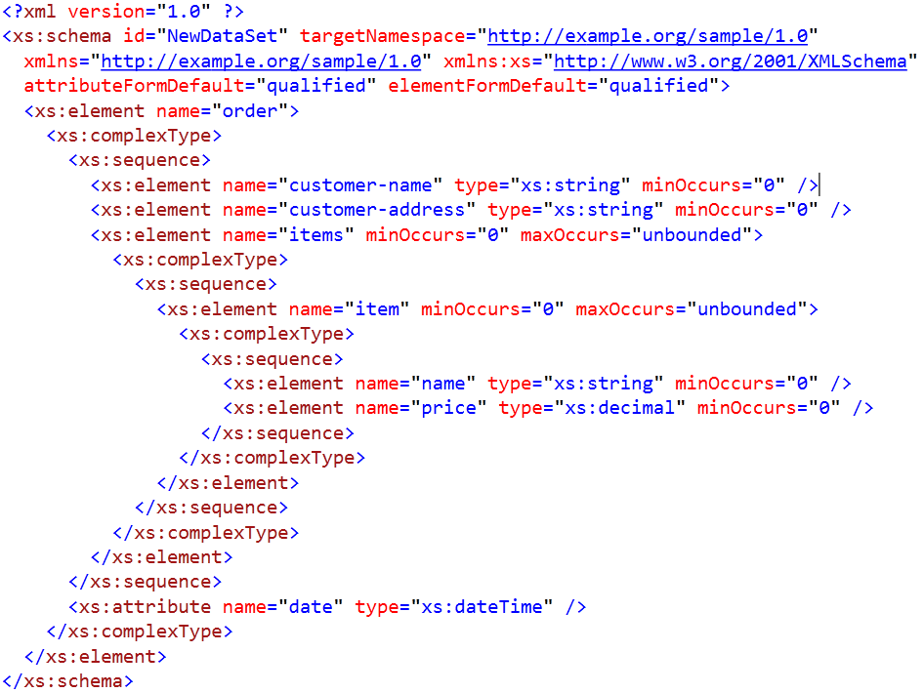

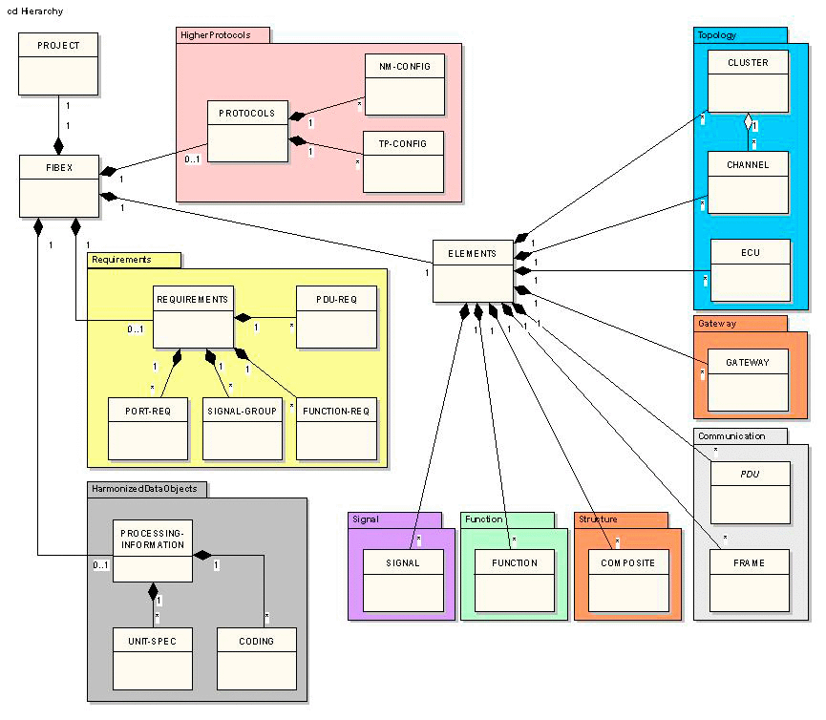

XML Schemas and Validation

Slide 22


XML Schemas and Validation
The XML document structure is defined by schemas
XML schemas describes:
Possible tags, attributes and their valid values (data types)
Default values and number of appearances
Tags order
There are few XML Schema standards:
DTD – Document Type Definition
XSD – XML Schema Definition Language

Slide 23
DTD Definition
DTD (Document Type Definition) is:
Formal language for describing XML document structures
Contains a set of rules for the tags and their attributes
Text-based language, but not XML based
Less powerful and more simple than XSD
<!ELEMENT library (book+)>
<!ATTLIST library name CDATA #REQUIRED>
<!ELEMENT book (title, author, isbn)>
<!ELEMENT title (#PCDATA)>
<!ELEMENT author (#PCDATA)>

Slide 24
XML Schema (XSD)
XML Schema (XSD, XML Schema Definition Language)
Powerful XML-based language for describing the structure of XML documents
Specifies a set of rules for the tags and attributes in a document
Specifies a few standard data types
Numbers (float, double, decimal), dates (ISO 8601), durations, strings, binary data (hex-encoded / base64-encoded), etc.
Specifies validation rules, e.g. by regular expression
XML Schema has more descriptive power than DTD

Slide 25
XML Schema (XSD) – Example
<?xml version="1.0" encoding="UTF-8"?>
<xs:schema xmlns:xs="http://www.w3.org/2001/XMLSchema"
targetNamespace="https://sample.org/library">
<xs:element name="library">
<xs:complexType>
<xs:sequence>
<xs:element ref="book" maxOccurs="unbounded" />
</xs:sequence>
<xs:attribute name="name" type="xs:string" use="optional" />
</xs:complexType>
</xs:element>
…

Slide 26
XML Schema (XSD) – Example (2)
<xs:element name="book">
<xs:complexType>
<xs:sequence>
<xs:element ref="title" />
<xs:element ref="author" />
<xs:element ref="isbn" />
</xs:sequence>
</xs:complexType>
</xs:element>
<xs:element name="title" type="xs:string" />
<xs:element name="author" type="xs:string" />
<xs:element name="isbn" type="xs:string" />
</xs:schema>

Slide 27
Referencing DTD from XML (Private)
<?xml version="1.0"?> <!DOCTYPE root-element SYSTEM "[URI]"> <root-element> …
</root-element>
The keyword "SYSTEM" means private (local) DTD
<?xml version="1.0"?> <!DOCTYPE library SYSTEM "http://127.0.0.1:8080/library/lib.xsd"> <library> <book>
…
</book> </library>
Root element
DTD location (local)

Slide 28
Referencing DTD from XML (Public)
The keyword "PUBLIC" means public DTD in Internet
<?xml version="1.0"?> <!DOCTYPE root-element PUBLIC
"[Formal Public Identifier (FPI)]" "[URI]"> <root-element> …
</root-element>
<?xml version="1.0" encoding="utf-8" ?>
<!DOCTYPE hibernate-mapping PUBLIC
"-//Hibernate/Hibernate Mapping DTD 3.0//EN"
"http://www.hibernate.org/dtd/hibernate-mapping-3.0.dtd">
<hibernate-mapping>
…
</hibernate-mapping>
DTD location (Internet URL)

Slide 29

DTD May be Embedded in the DOCTYPE
<?xml version="1.0"?>
<!DOCTYPE note [
<!ELEMENT note (to,from,heading,body)>
<!ELEMENT to (#PCDATA)>
<!ELEMENT from (#PCDATA)>
<!ELEMENT heading (#PCDATA)>
<!ELEMENT body (#PCDATA)>
]>
<note>
<to>Tove</to>
<from>Jani</from>
<heading>Reminder</heading>
<body>Don't forget me this weekend</body>
</note>

Slide 30
Referencing XSD from XML
<?xml version="1.0"?> <root-element xmlns="[namespace]"
xmlns:xsi="http://www.w3.org/2001/XMLSchema-instance"
xsi:schemaLocation="[namespace URI] [namespace URI] …">
…
</root-element>
<p:person xmlns:xsi="http://www.w3.org/2001/XMLSchema-instance"
xmlns:p="urn:sample:people" xsi:schemaLocation=
"urn:sample:people http://sample.org/people.xsd">
<p:name>John</p:name>
</p:person>
Validate XML by XSD online: http://www.freeformatter.com/xml-validator-xsd.html

Slide 31
Referencing XSD from XML – Example
<p:Person
xmlns:p="http://sample.org/People" xmlns:v="http://sample.org/Vehicles"
xmlns:xsi="http://www.w3.org/2001/XMLSchema-instance"
xsi:schemaLocation=
"http://sample.org/People http://sample.org/people.xsd
http://sample.org/schemas/Vehicles http://sample.org/vehicles.xsd">
<name>John</name>
<age>28</age>
<v:Vehicle>
<color>Red</color>
<wheels>4</wheels>
<seats>2</seats>
</v:Vehicle>
</p:Person>

Slide 32

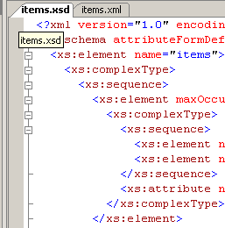
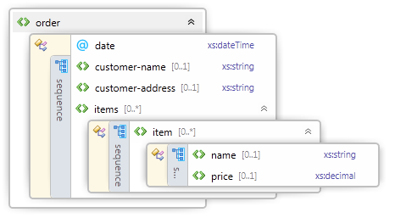
Visual Studio Schema Editor
Visual Studio has powerful XSD Schema Editor
Can generate XSD Schema by existing XML document

Slide 33

Working with the XSD Editor in Visual Studio
Live Demo

Slide 34




XML Parsers
DOM, SAX and StAX Parsers

Slide 35
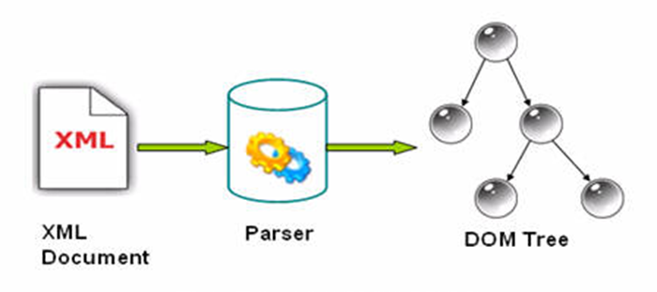
XML Parsers
XML parsers are programming libraries that process XML
Typical functions of an XML parser:
Extracting data from XML documents
Modifying existing XML documents
Building new XML documents
Validating XML documents by given schema / DTD
Transforming XML documents
Searching in a XML document

Slide 36
XML Parsers: Working Models
They have several working models:
DOM (Document Object Model)
Represents XML documents as a DOM tree in the memory
Allows processing and modifying the document
SAX (Simple API for XML Processing)
Reads XML documents consequently tag by tag
Event-driven API: analyze the read portions at each step
StAX (Streaming API for XML)
Like SAX but works in "pull" mode

Slide 37
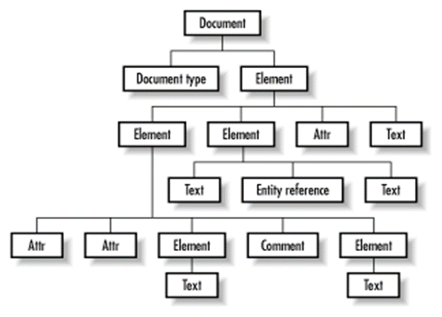
The DOM Parser
Load the following XML document as DOM tree:
<?xml version="1.0"?>
<library name=".NET Developer's Library">
<book>
<title>Professional C# 4.0 and .NET 4</title>
<author>Christian Nagel</author>
<isbn>978-0-470-50225-9</isbn>
</book>
<book>
<title>Silverlight in Action</title>
<author>Pete Brown</author>
<isbn>978-1-935182-37-5</isbn>
</book>
</library>

Slide 38
The DOM Parser (2)
The corresponding DOM tree:
Header (prolog)
Root element

Slide 39
The SAX Parsers
The SAX parsers:
Iterate over a XML document consequently tag by tag
Invoke callback functions (events) when particular node is reached
Streaming-style access
Going backwards or jumping ahead is not allowed
Require many times less resources (memory and CPU time)
Works well over streams and big XML documents

Slide 40
The StAX Parser
StAX is like SAX but
"Pull"-based parser
Not event driven (not callback based)
Developer manually say "go to next element" and analyze it
SAX vs. StAX
SAX reads the documents and invokes callbacks like "node found", "attribute found", etc.
In StAX parsers the read is invoked by the developer synchronously → easier for developers

Slide 41
When to Use DOM and SAX / StAX?
Use DOM processing model when:
Process small documents (e.g. less than 10 MB)
There is a need of flexibility
To modify XML documents
Use SAX / StAX processing model when:
Process big documents (hundreds of MB)
The processing speed is important
There is no need to modify the document

Slide 42


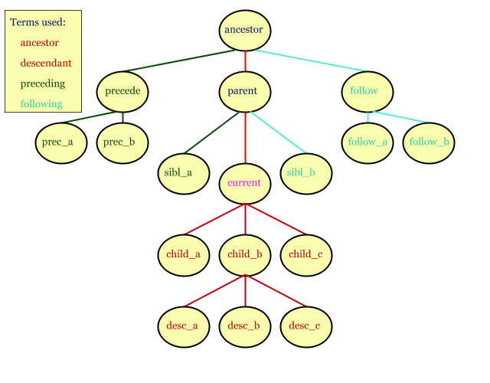
XPath
Searching in XML Documents

Slide 43
What is XPath?
XPath (XML Path Language) is a language for
Addressing parts of XML documents (searching)
XPath expressions describe of paths to nodes and filter criteria
Sample XPath expressions:
/library/book[isbn='1-930110-19-7']
/catalog/cd[@price<10.80]
/book/chapter[3]/paragraph[last()]

Slide 44
XPath Expressions
/ – addresses the root element
/someNode – addresses all nodes with name "someNode", direct children of the root
/books/book – addresses all nodes "book", direct inheritors of the node "books"
/books/book[price<10]/author – addresses all authors (/books/book/author), whose books have element price < 10
/items/item[@type="food"] – addresses all nodes with name item (/items/item/), which have attribute "type" with value "food"

Slide 45
XPath – Example
<?xml version="1.0"?>
<library name="Developer's Library">
<book>
<title>Professional C# 4.0</title>
<author>Christian Nagel</author>
<isbn>978-0-470-50225-9</isbn>
</book>
<book>
<title>Teach Yourself XML</title>
<author>Andrew H. Watt</author>
<isbn>978-0-672-32471-0</isbn>
</book>
</library>
var nodes = xmlDoc.selectNodes(
"/library/book/title");
// "nodes" holds an iterator over all <title> elements
// Print the books titles
foreach (var node in nodes) {
var title = node
.ChildNodes[0].Value);
Console.WriteLine(title);
}

Slide 46
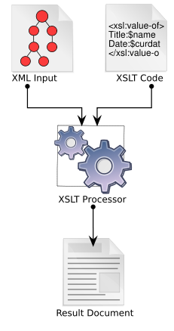
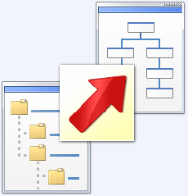
XSL Transformations (XSLT)
XSL

Slide 47
XSL and XSLT (XSL Transformations)
Extensible Stylesheet Language (XSL) specifies
How to transform and visualize a XML document
XSL transformations (XSLT)
Transform XML document to different XML format by XSL stylesheet
XSLT depends on XPath
XPath matches parts (fragments) from the input XML document
Matched fragments are replaces with other XML fragments
XSLT can transform XML documents to XHTML

Slide 48
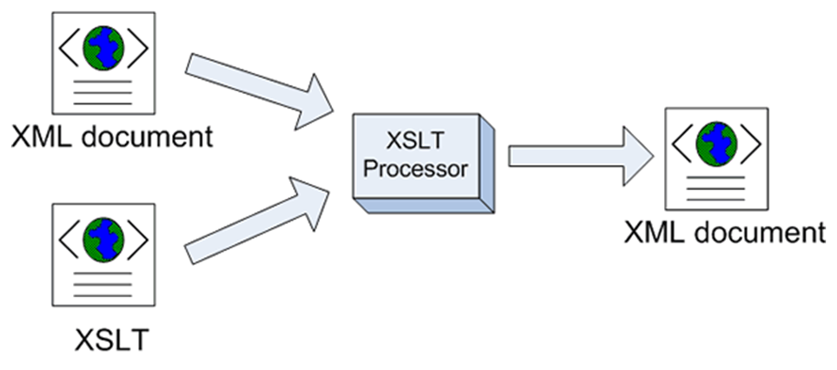
XSL Stylesheet – Example
<?xml version="1.0" encoding="utf-8"?>
<xsl:stylesheet version="1.0" xmlns:xsl="http://www.w3.org/1999/XSL/Transform">
<xsl:template match="/">
<html>
<body>
<h1>My Library</h1>
<table bgcolor="#E0E0E0" cellspacing="1">
<tr bgcolor="#EEE"><td><b>Title</b></td><td><b>Author</b></td></tr>
<xsl:for-each select="/library/book">
<tr bgcolor="white">
<td><xsl:value-of select="title"/></td>
<td><xsl:value-of select="author"/></td>
</tr>
</xsl:for-each>
</table>
</body>
</html>
</xsl:template>
</xsl:stylesheet>

Slide 49
The XSL Stylesheet Language
<xsl:template match="XPath expr."> … </xsl:template>
Replaces the pointed with XPath expression part of the document with the provided XML fragment
<xsl:for-each select="XPath expr."> … </xsl:for-each>
Replaces each node, selected by the XPath expression with the provided XML fragment
<xsl:value-of select="XPath expr." />
Extracts the value of the given XPath expression (first occurrence)
XSL stylesheets should be valid XML documents

Slide 50
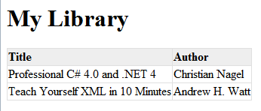
Referencing XSL from XML
<?xml version="1.0"?>
<?xml-stylesheet type="text/xsl" href="library-xml2html.xsl"?>
<library name="Developer's Library">
<book>
<title>Professional C# 4.0 and .NET 4</title>
<author>Christian Nagel</author>
<isbn>978-0-470-50225-9</isbn>
</book>
<book>
<title>Teach Yourself XML …</title>
<author>Andrew H. Watt</author>
<isbn>978-0-672-32471-0</isbn>
</book>
</library>

Slide 51
XSL Stylesheets
XSL
Live Demo

Slide 52







Basic XML Concepts
https://softuni.bg/courses/database-applications

Slide 53
License
This course (slides, examples, demos, videos, homework, etc.) is licensed under the "Creative Commons Attribution-NonCommercial-ShareAlike 4.0 International" license
Attribution: this work may contain portions from
"Databases" course by Telerik Academy under CC-BY-NC-SA license

Slide 54





Free Trainings @ Software University
Software University Foundation – softuni.org
Software University – High-Quality Education, Profession and Job for Software Developers
softuni.bg
Software University @ Facebook
facebook.com/SoftwareUniversity
Software University @ YouTube
youtube.com/SoftwareUniversity
Software University Forums – forum.softuni.bg

